Slide 1
Numerical Examples

Slide 2
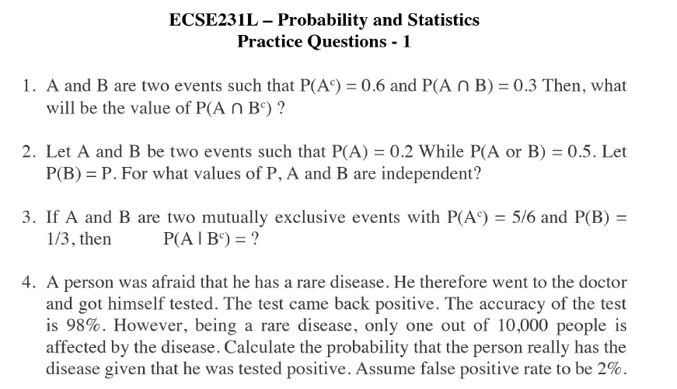

Practice Set based questions

Slide 5
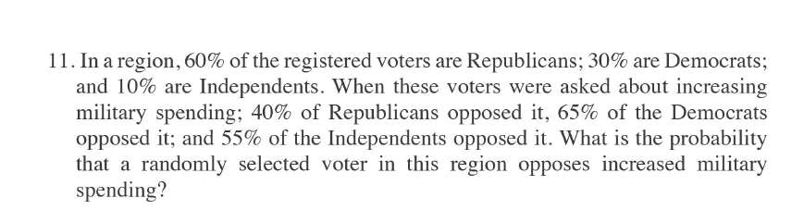
Practice Set Question

Slide 6


Slide 7
Question
45% of the children in a school have a dog, 30% have a cat, and 18% have a dog and a cat. What percent of those who have a dog also have a cat?

Slide 8
Question
It is estimated that 50% of emails are spam emails. Some software has been applied to filter these spam emails before they reach your inbox. A certain brand of software claims that it can detect 99% of spam emails, and the probability for a false positive (a non-spam email detected as spam) is 5%. Now if an email is detected as spam, then what is the probability that it is in fact a non-spam email?

